Slide 1


Predictions of Severe Weather with Random Forests and the Global Ensemble Forecast System
Aaron J. Hill and Russ S. Schumacher
Colorado State University
Along with NOAA partners: Israel Jirak (SPC), Mark Klein and Jim Nelson (WPC)​
And contributions from Allie Mazurek (CSU) and Hanna McDaniel (Florida State University)​
2023 European Conference on Severe Storms Bucharest, Romania
10 May 2023
Research supported by NOAA JTTI grant NA20OAR4590350

Slide 2
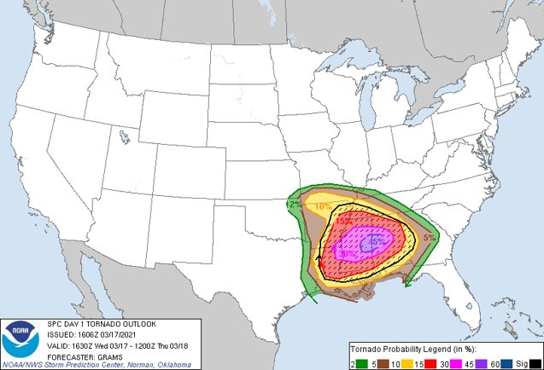
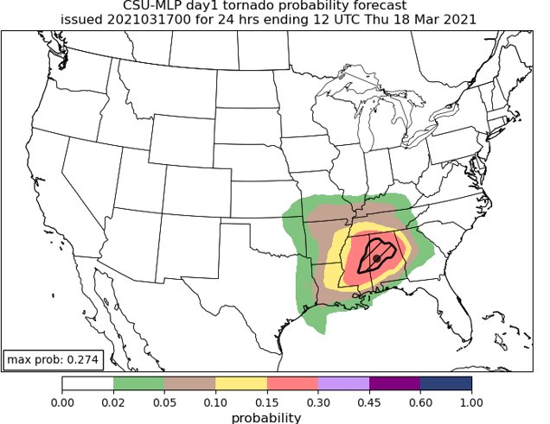
Question: How can machine learning (ML) be leveraged for high-impact weather forecasting?
Colorado State University Machine Learning Probabilities
(CSU-MLP; Hill et al. 2020, 2023)
Daily hazardous weather forecasts out to 8 days
Real-time forecasts in support of NOAA operations ​
→ Coarser model input that drives the machine learning-based predictions
Notes:
ML is becoming more prevalent in weather forecasting as an alternative means to leverage the numerous and vast datasets that dynamical models produce
As one example, there are now (that we know of) three separate ML systems that forecast severe weather by emulating Storm Prediction Center outlooks
These are based on the HREF, HRRR, and GEFS (loken, Sobash, Hill)

Slide 3
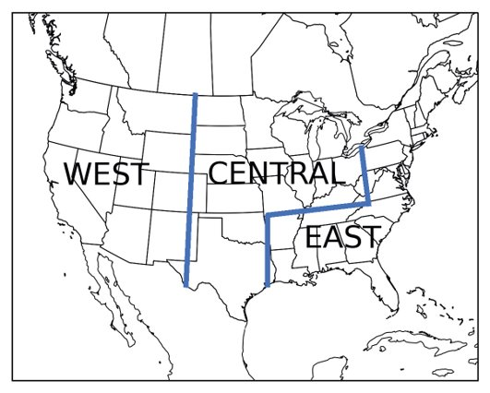
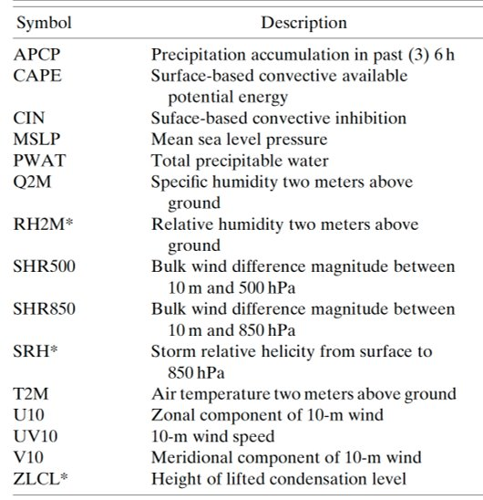
Approach
INPUTS
NOAA’s FV3-GEFS Reforecast Dataset (Hamill et al. 2022): 5 ensemble members, matches current GEFSv12 ​
Use many atmospheric fields as predictors (see table below), train random forest models over 3 distinct regions
​
We use April 2003 – April 2012 as the training period
​
OUTPUTS/LABELS
Observations from Storm Prediction Center’s (SPC) severe weather reports database (i.e., Storm Data)​
Forecasts made for individual hazards (tornado, hail, wind) on days 1-3, and aggregate severe threat on days 3-8; 24-hour probabilities ​
Guidance being evaluated in SPC operations since mid-2021​
Notes:
One of the reasons these types of systems are being pursued is the operational benefit that might be incurred
In Hill et al. 2020, SPC outlooks and RF-based forecasts of severe weather (individual hazards as well as aggregate hazards) were evaluated against one another.
One important outcome of that work was that a combination of SPC and RF outlooks (i.e., blend) often outperformed either individual component
In other words, the incorporation (in our example a statistical manner) of ML-based guidance was improving upon the human forecasts
One additional outcome, that motivates the rest of this presentation, is the benefit was that was seen beyond day 1
ML forecasts (and the blends) were improved at days 2 and 3 over SPC outlooks

Slide 4
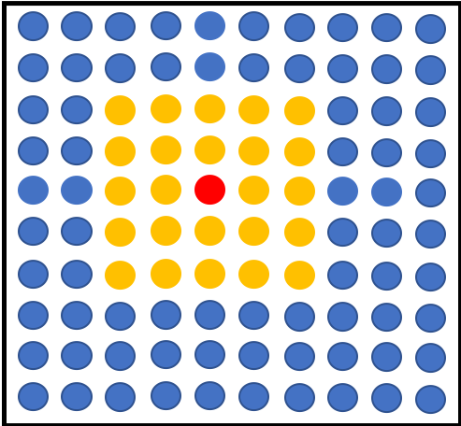
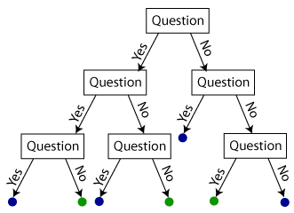
Random Forests
Forecast point
A set of decision trees that contain a series of yes/no questions based on the inputs that allow traversal of the tree
Corresponding events of severe weather are assigned to the “leaf” nodes​
Relative frequency of events in the forest is the forecast probability​
Python package "determines" best predictors that discriminate events​
Temperature at (-2, -1) > 20 C?
…..
CAPE at (1, -2) > 500 J/kg?
Probability of severe hail
50%

Slide 5
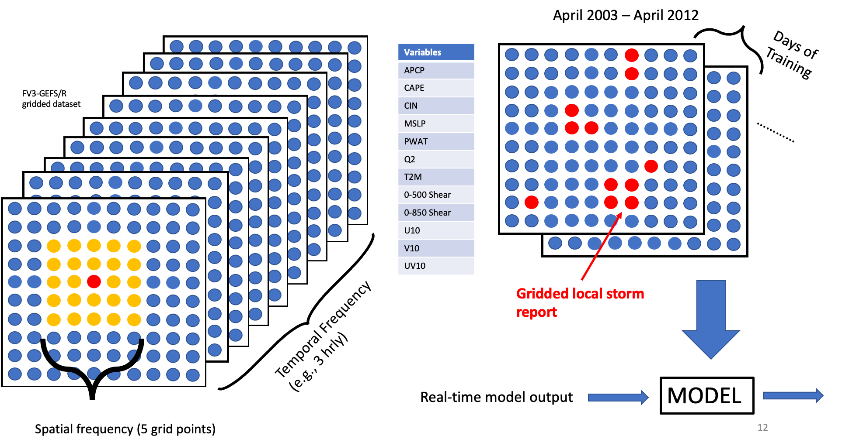
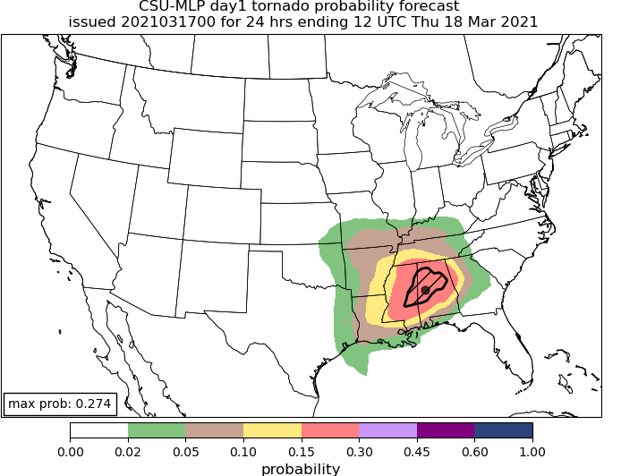
Random Forest Configuration
Ensemble median
Gridded local storm report
Over 20 million training examples and >6000 predictors per

Slide 6
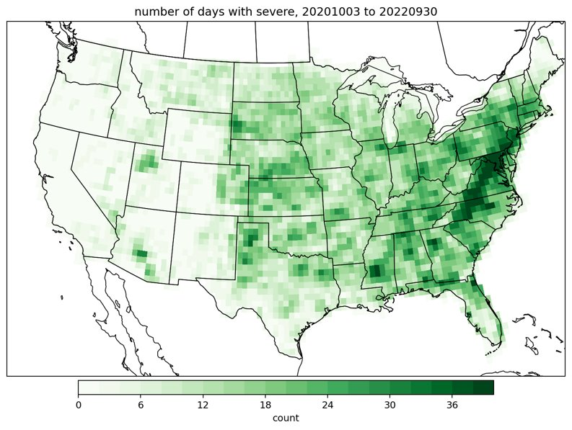
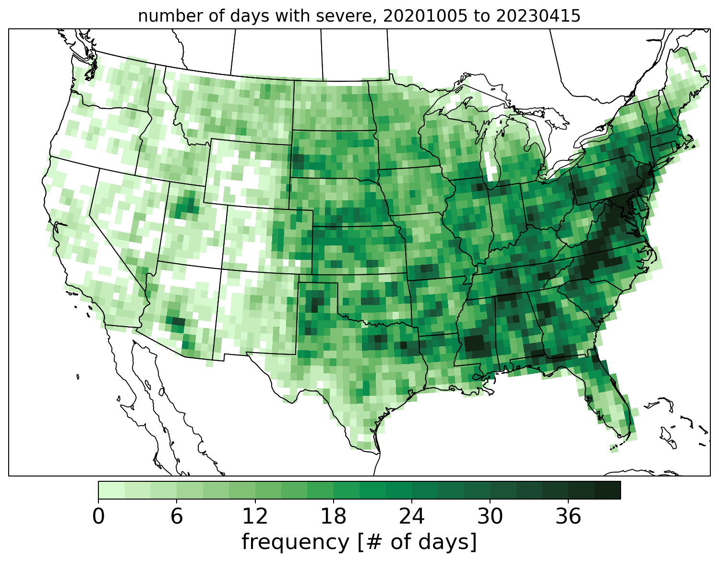
Analysis Methods
CSU-MLP forecasts are evaluated against gridded severe weather reports​
Evaluation from 3 October 2020 through 10 April 2023
Forecast performance is compared to SPC’s outlooks, issued at 1300 UTC (day 1), 0700 UTC (day 2), and 0730/0830 UTC (day 3)​
CSU-MLP forecasts are discretized to the SPC outlook probability categories
Number of days with severe weather in the analysis period​

Slide 7
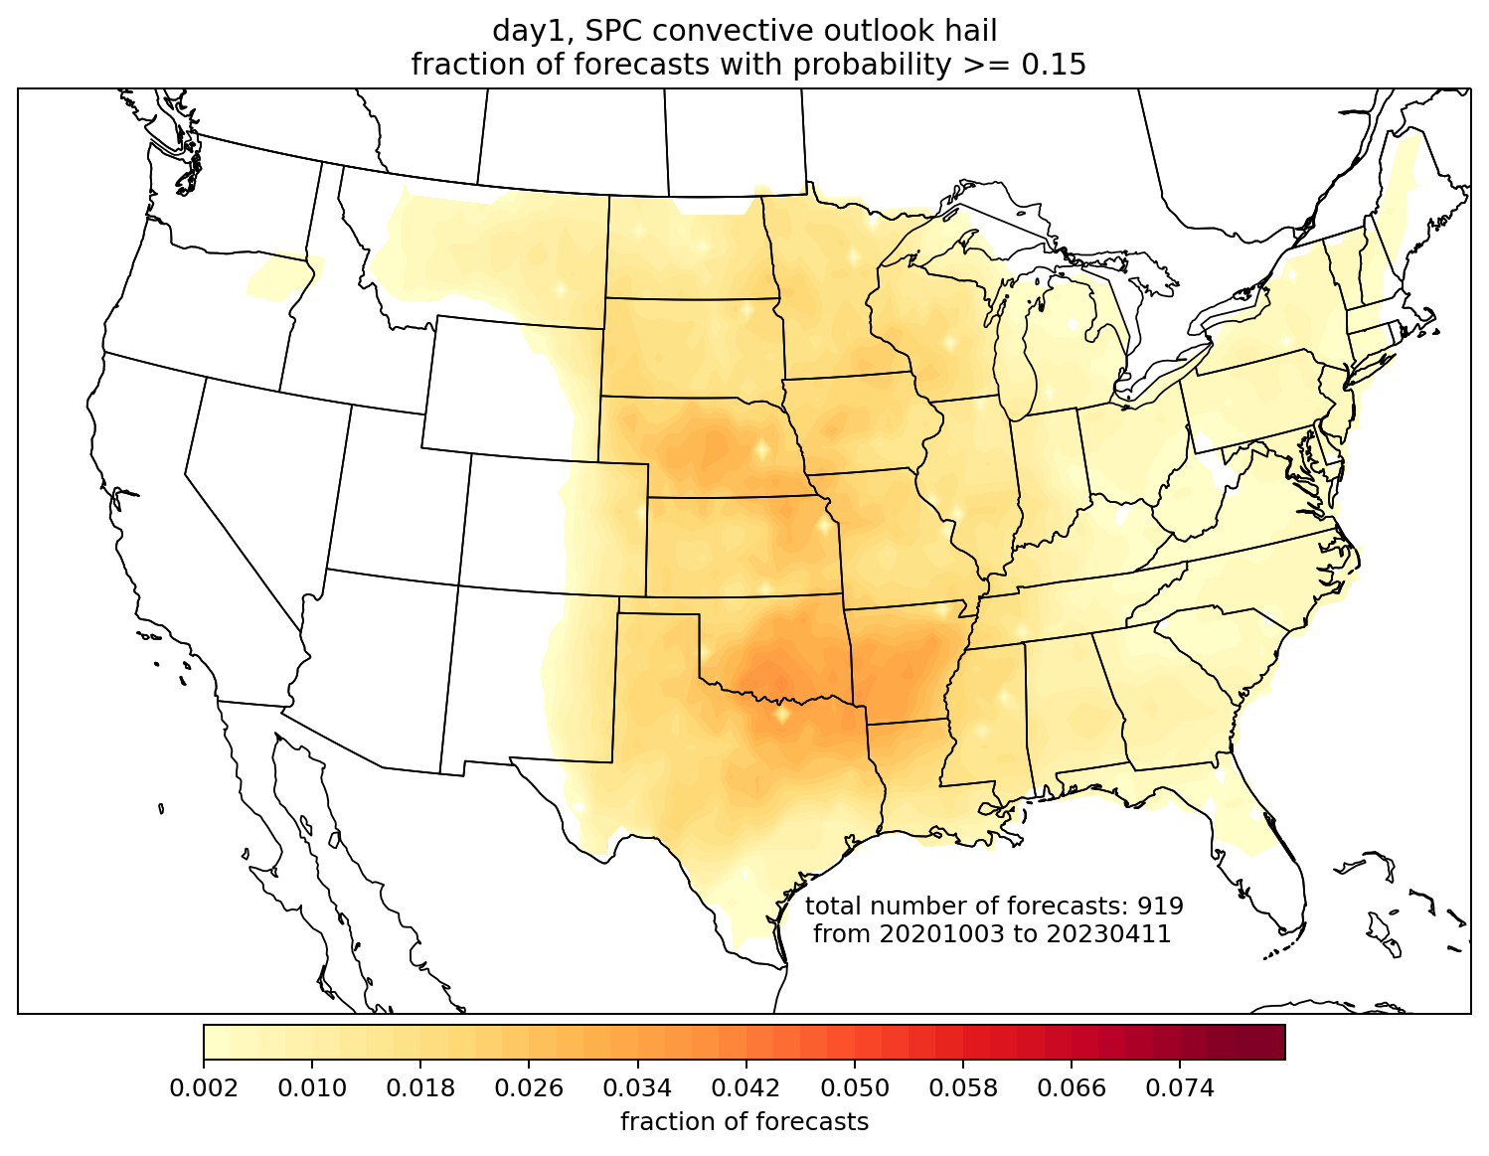
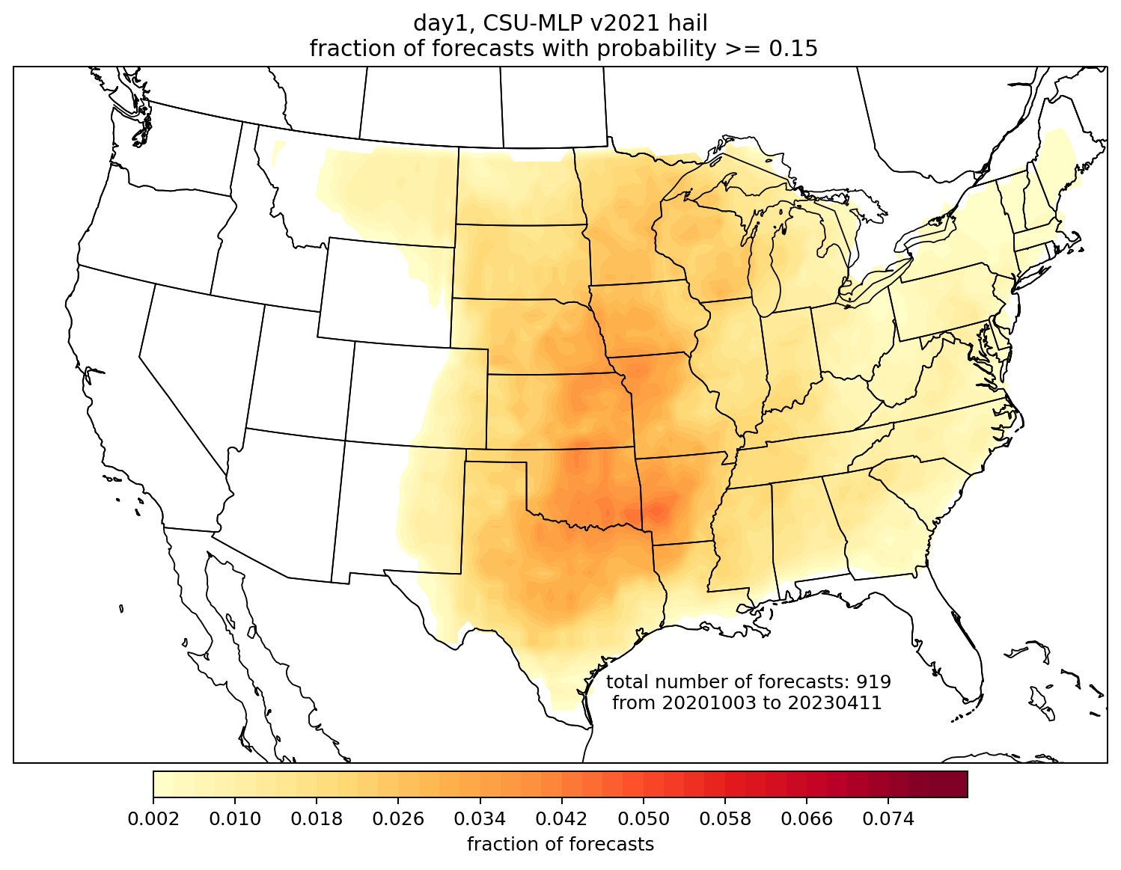
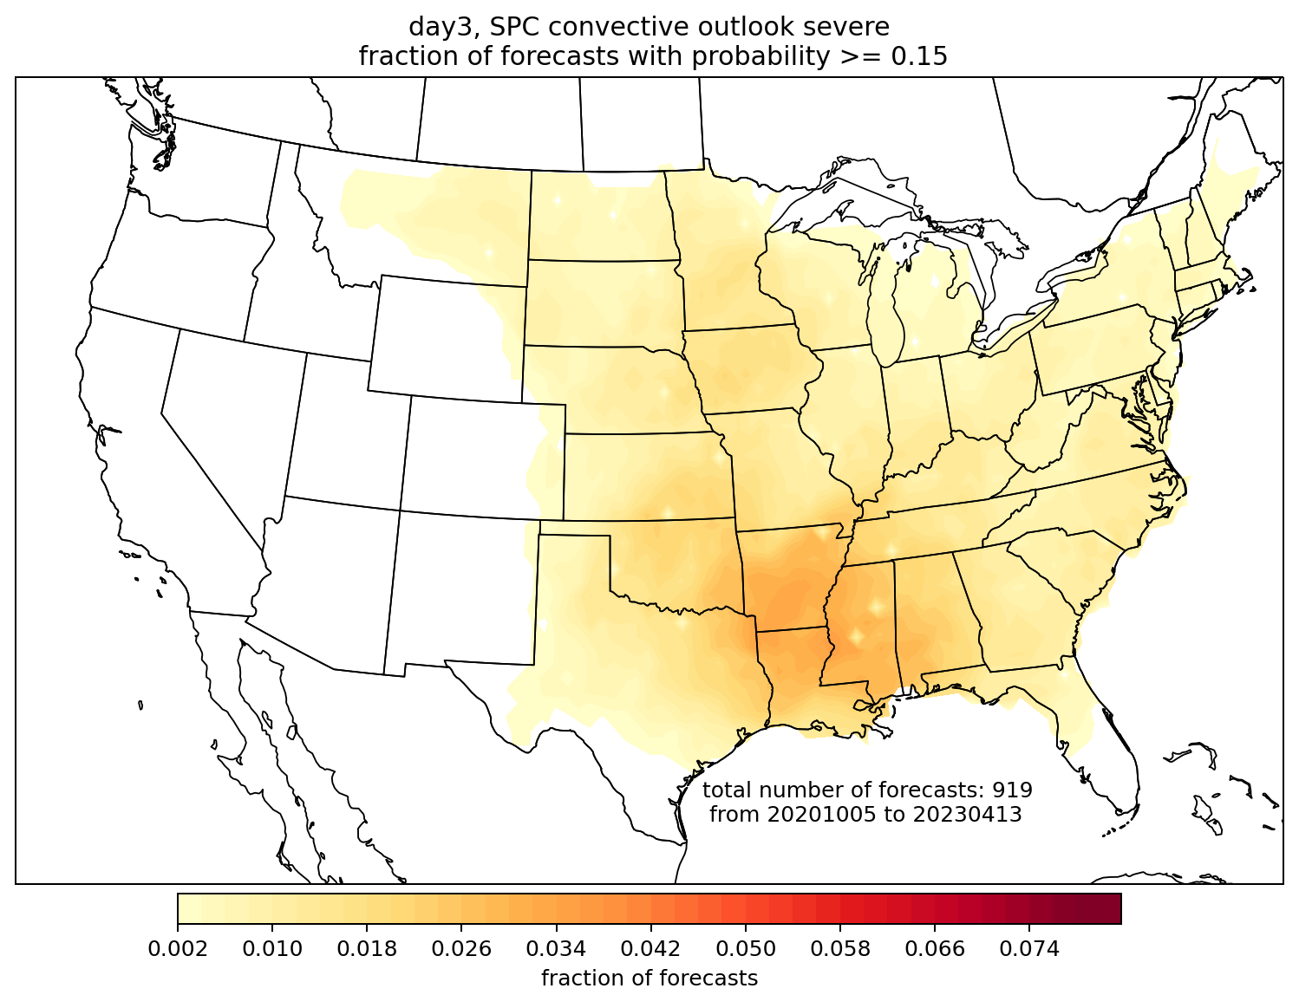
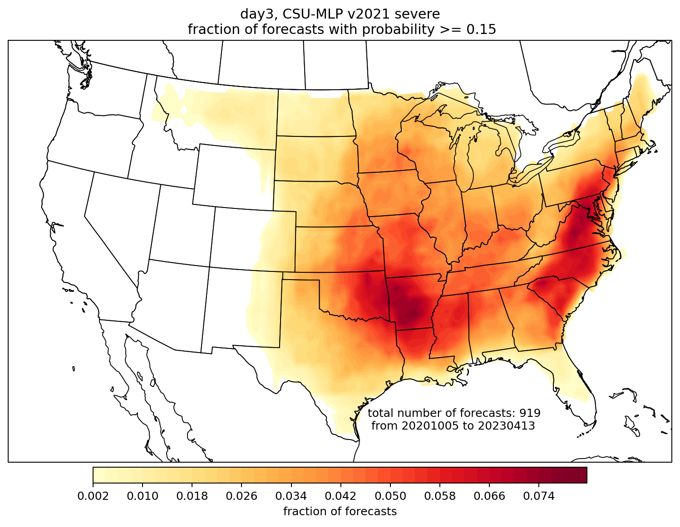
CSU-MLP forecast probabilities are issued at similar frequency to SPC on day 1; much more frequently on day 3
Day 1 hail, 15%
SPC
CSU-MLP
Day 3,
all severe, 15%
SPC
CSU-MLP

Slide 8
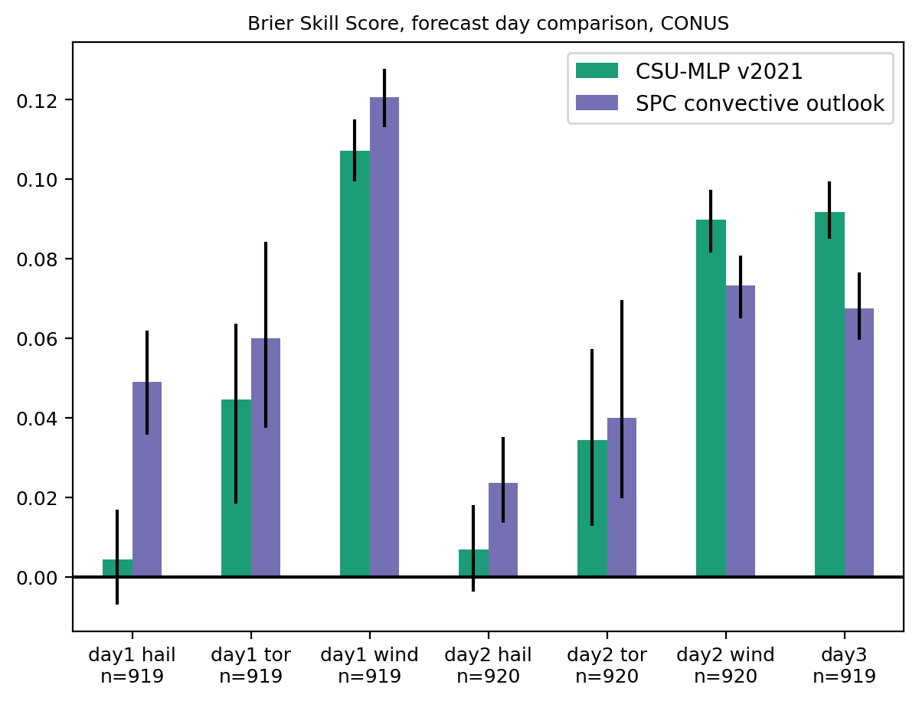
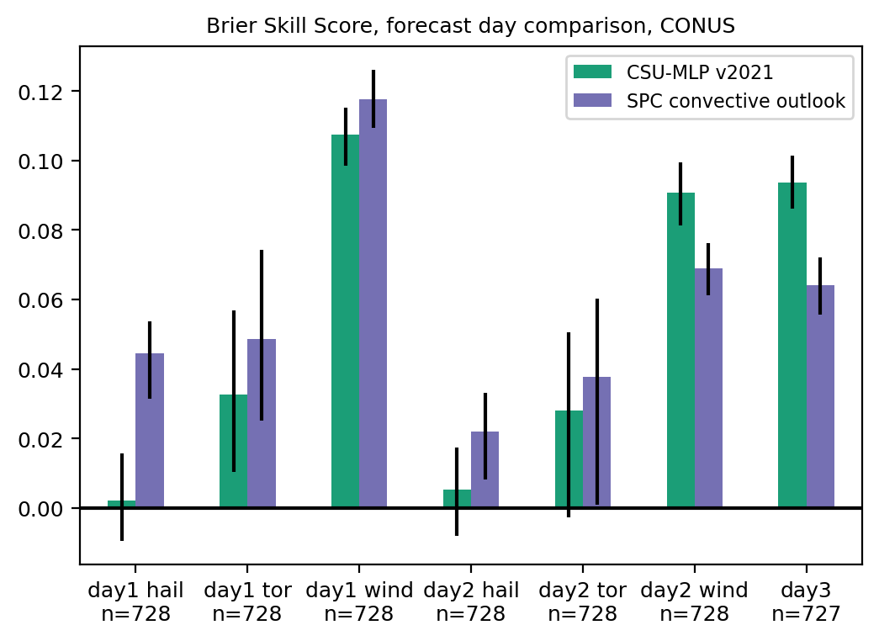
Brier skill score, by day and hazard
DAY 1
DAY 2
DAY 3
HAIL
TOR
WIND
HAIL
TOR
WIND
ALL
SPC’s expertise really shows on day 1: they have higher skill for all hazards
Both SPC and CSU-MLP were most skillful for wind, least for hail
CSU-MLP was more skillful for day 2 wind and day 3 aggregate severe

Slide 9
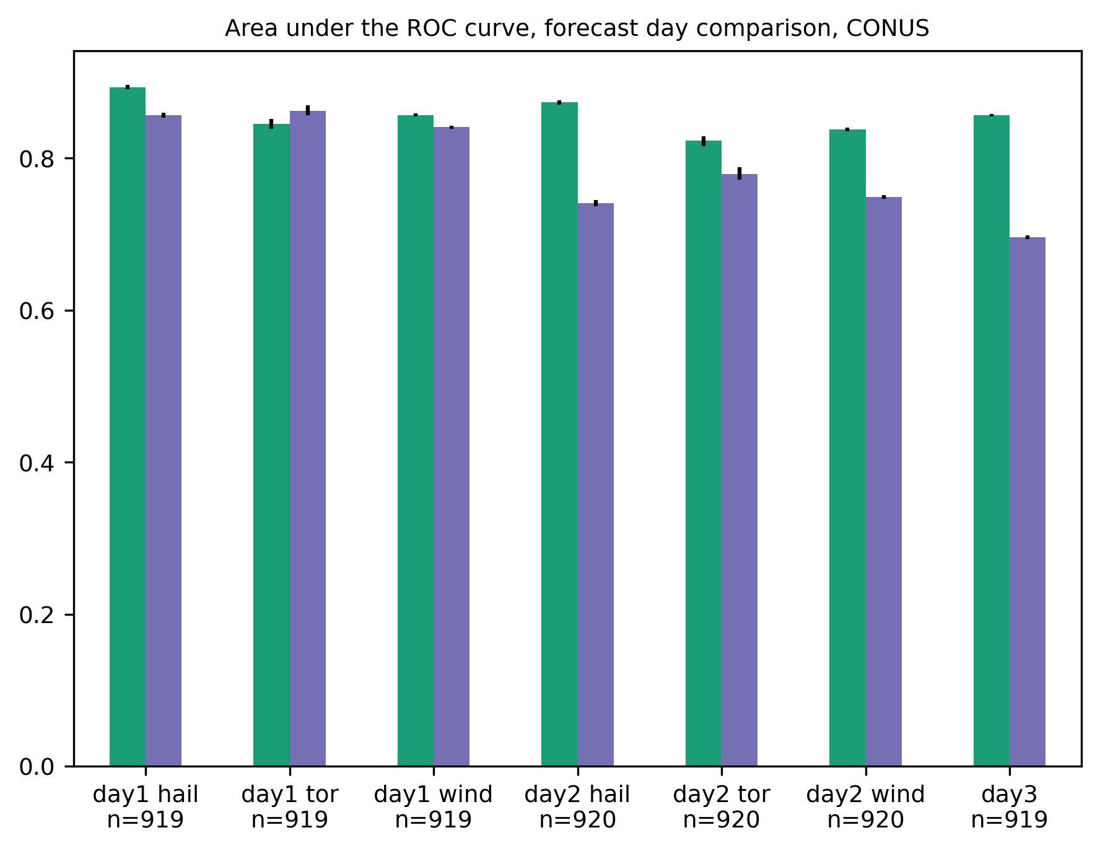
Area under the ROC curve, by day and hazard
DAY 1
DAY 2
DAY 3
ROC area for hail forecasts is quite high even though BSS was low - suggests potential for further improvement with better calibration

Slide 10
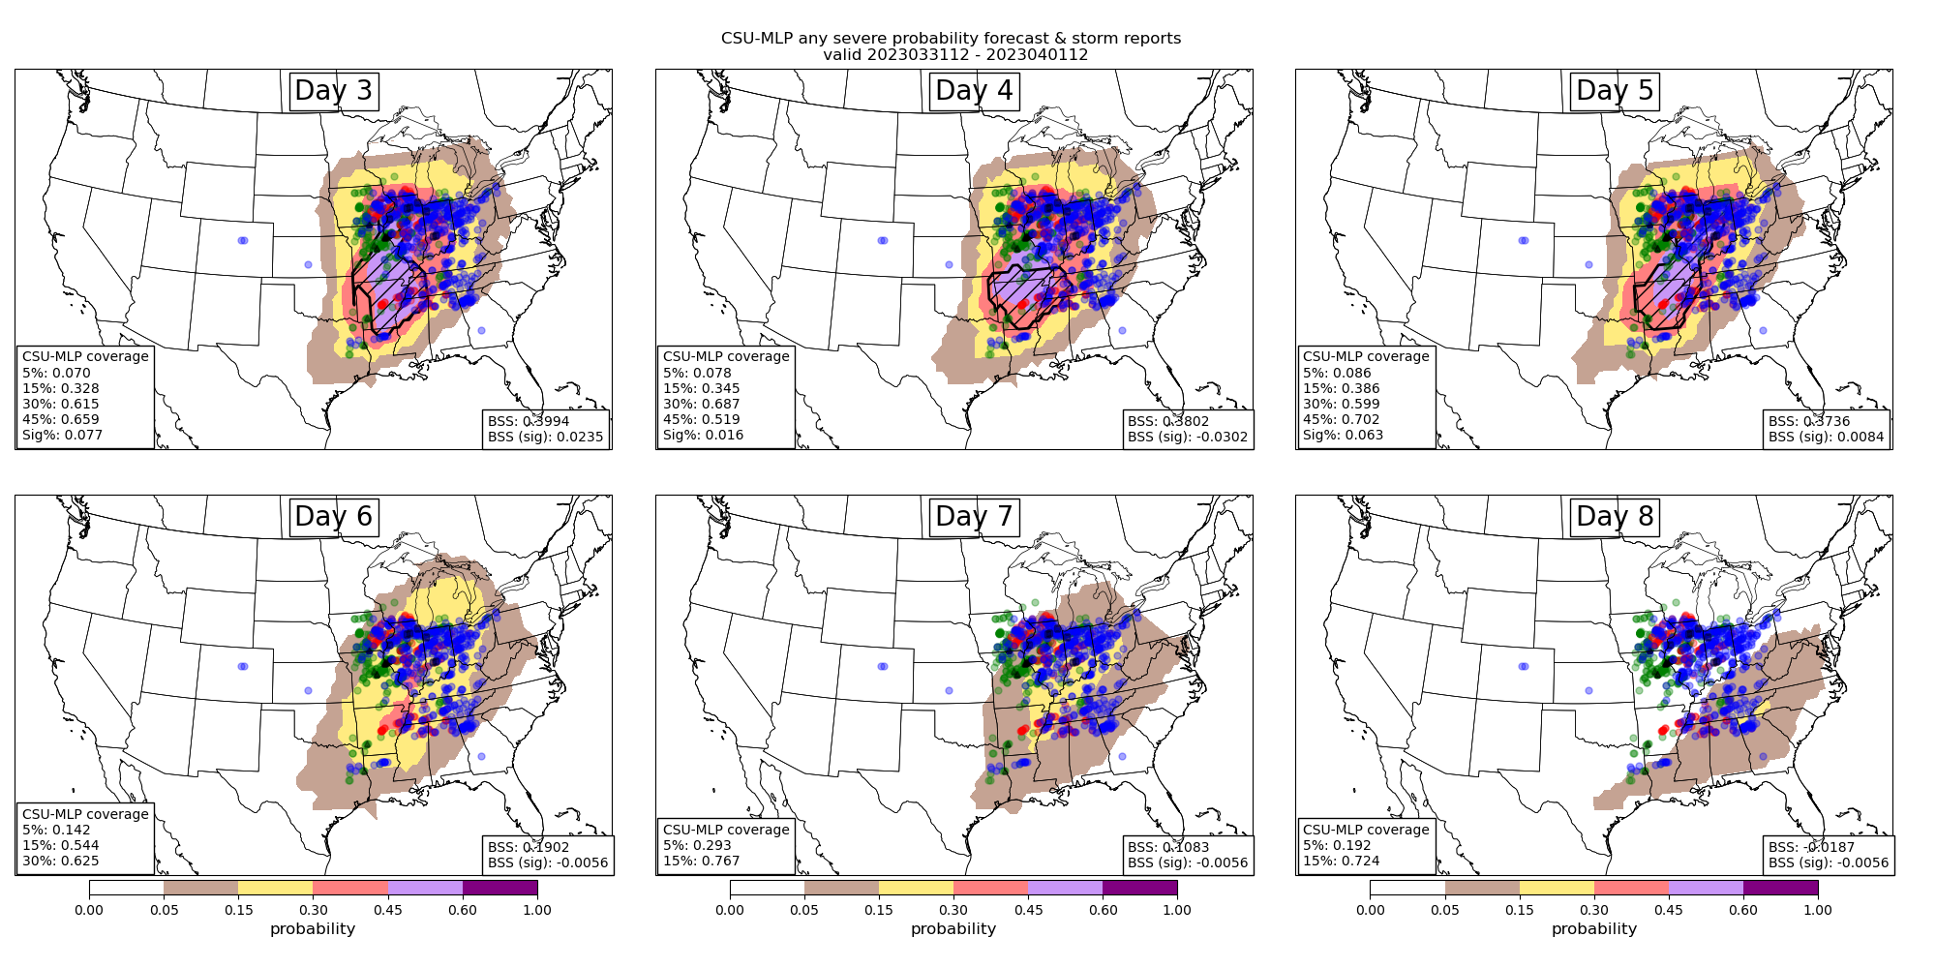
31 March 2023 outbreak

Slide 11
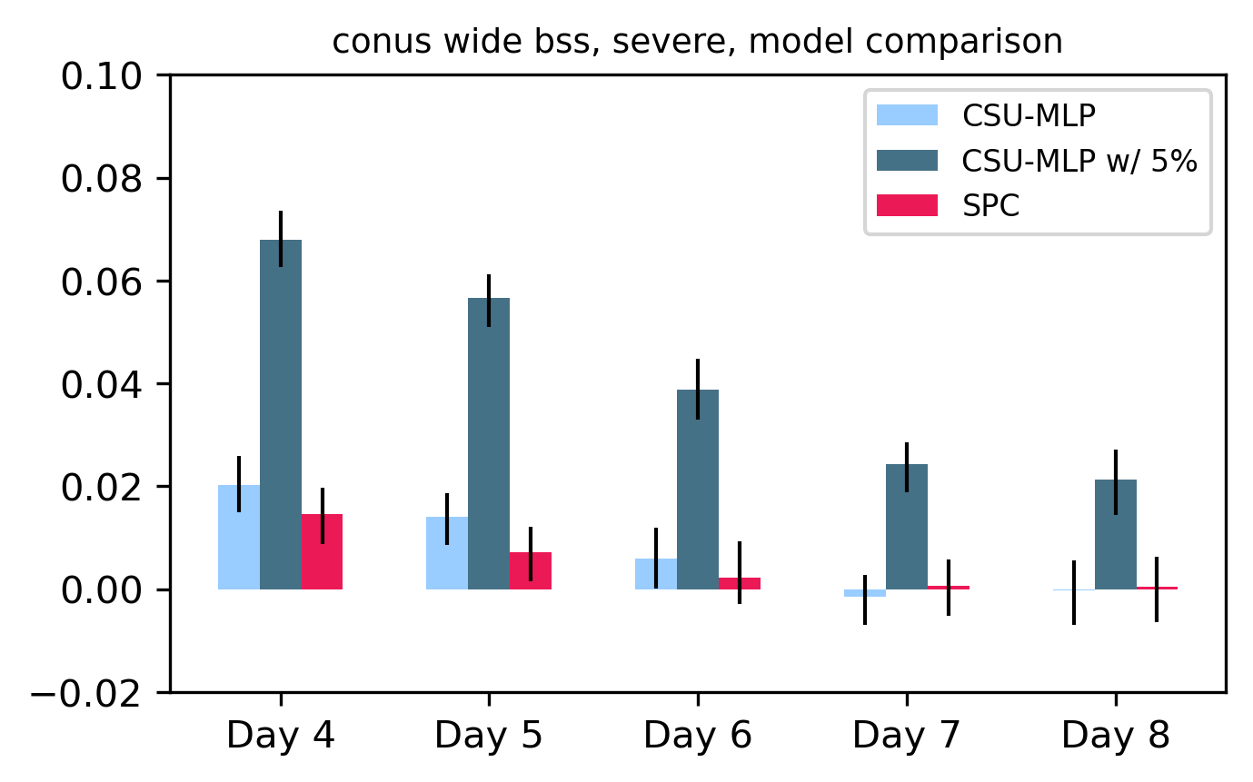
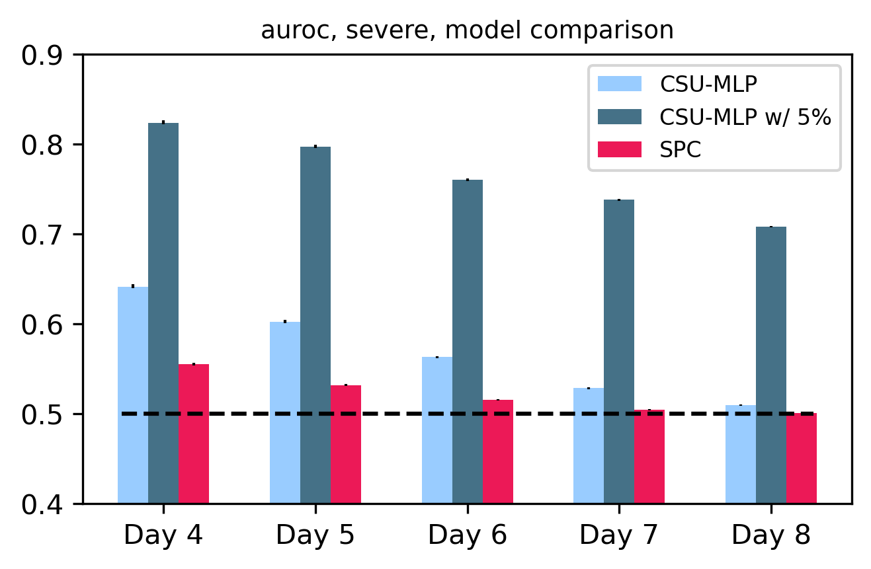
Forecast skill and discrimination out to day 6
Includes 5% contour in discretization
Brier Skill Score
Area under the ROC
October 2020 – April 2023 verification

Slide 12
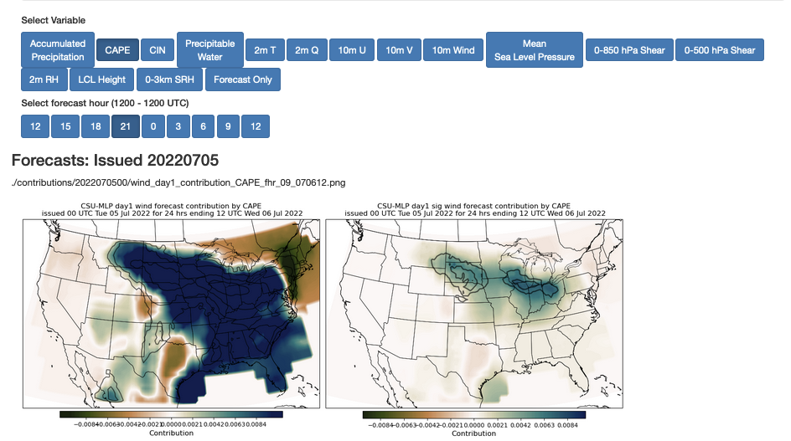
The future: diagnosis of how environmental parameters are influencing the forecast
Work by Aaron Hill and REU student Hanna McDaniel, using Tree Interpreter package

Slide 13
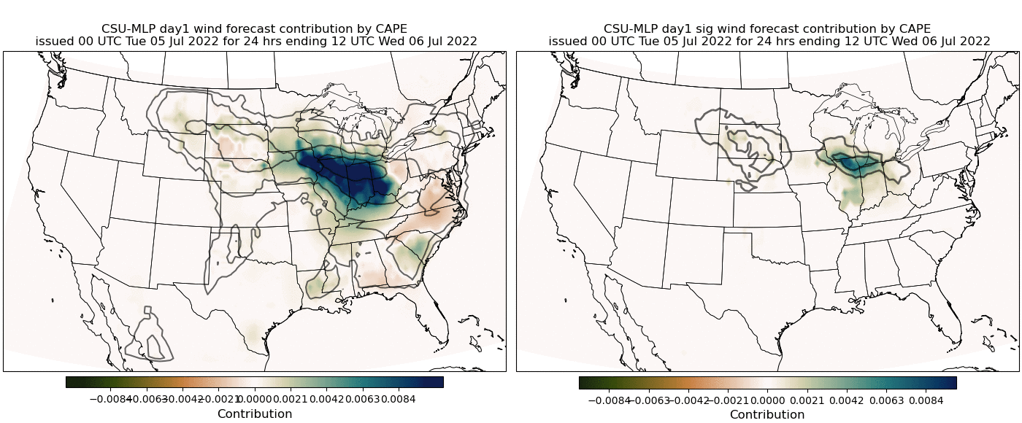
The future: diagnosis of how environmental parameters are influencing the forecast
Forecast of 5-6 July 2022 South Dakota derecho
Solid contours: CSU-MLP probability forecast
Shading: Contribution to that probability by CAPE
Work by Aaron Hill and REU student Hanna McDaniel, using Tree Interpreter package

Slide 14
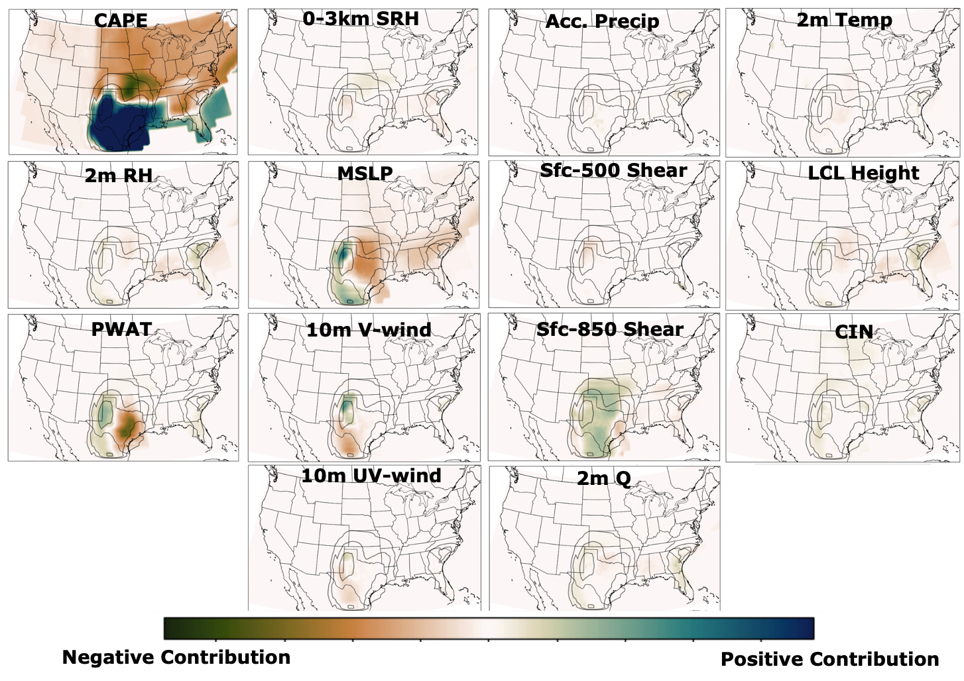
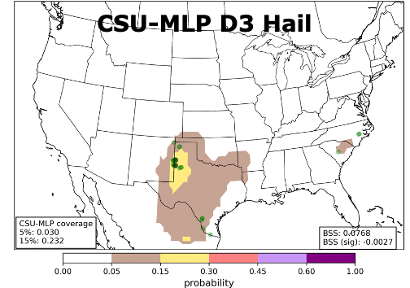
The future: diagnosis of how environmental parameters are influencing the forecast
Credit: Allie Mazurek
Example: Day 3 hail forecast contributions for 23 May 2022 at forecast hour 2100 UTC
Can spatially interpret which fields are supplying key information to the forecast probs

Slide 15
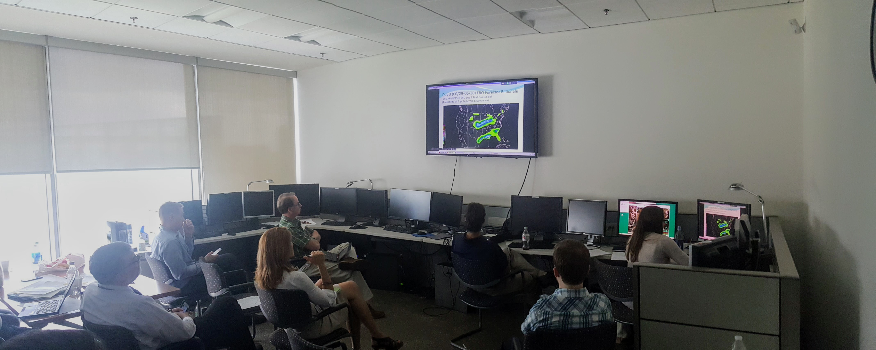
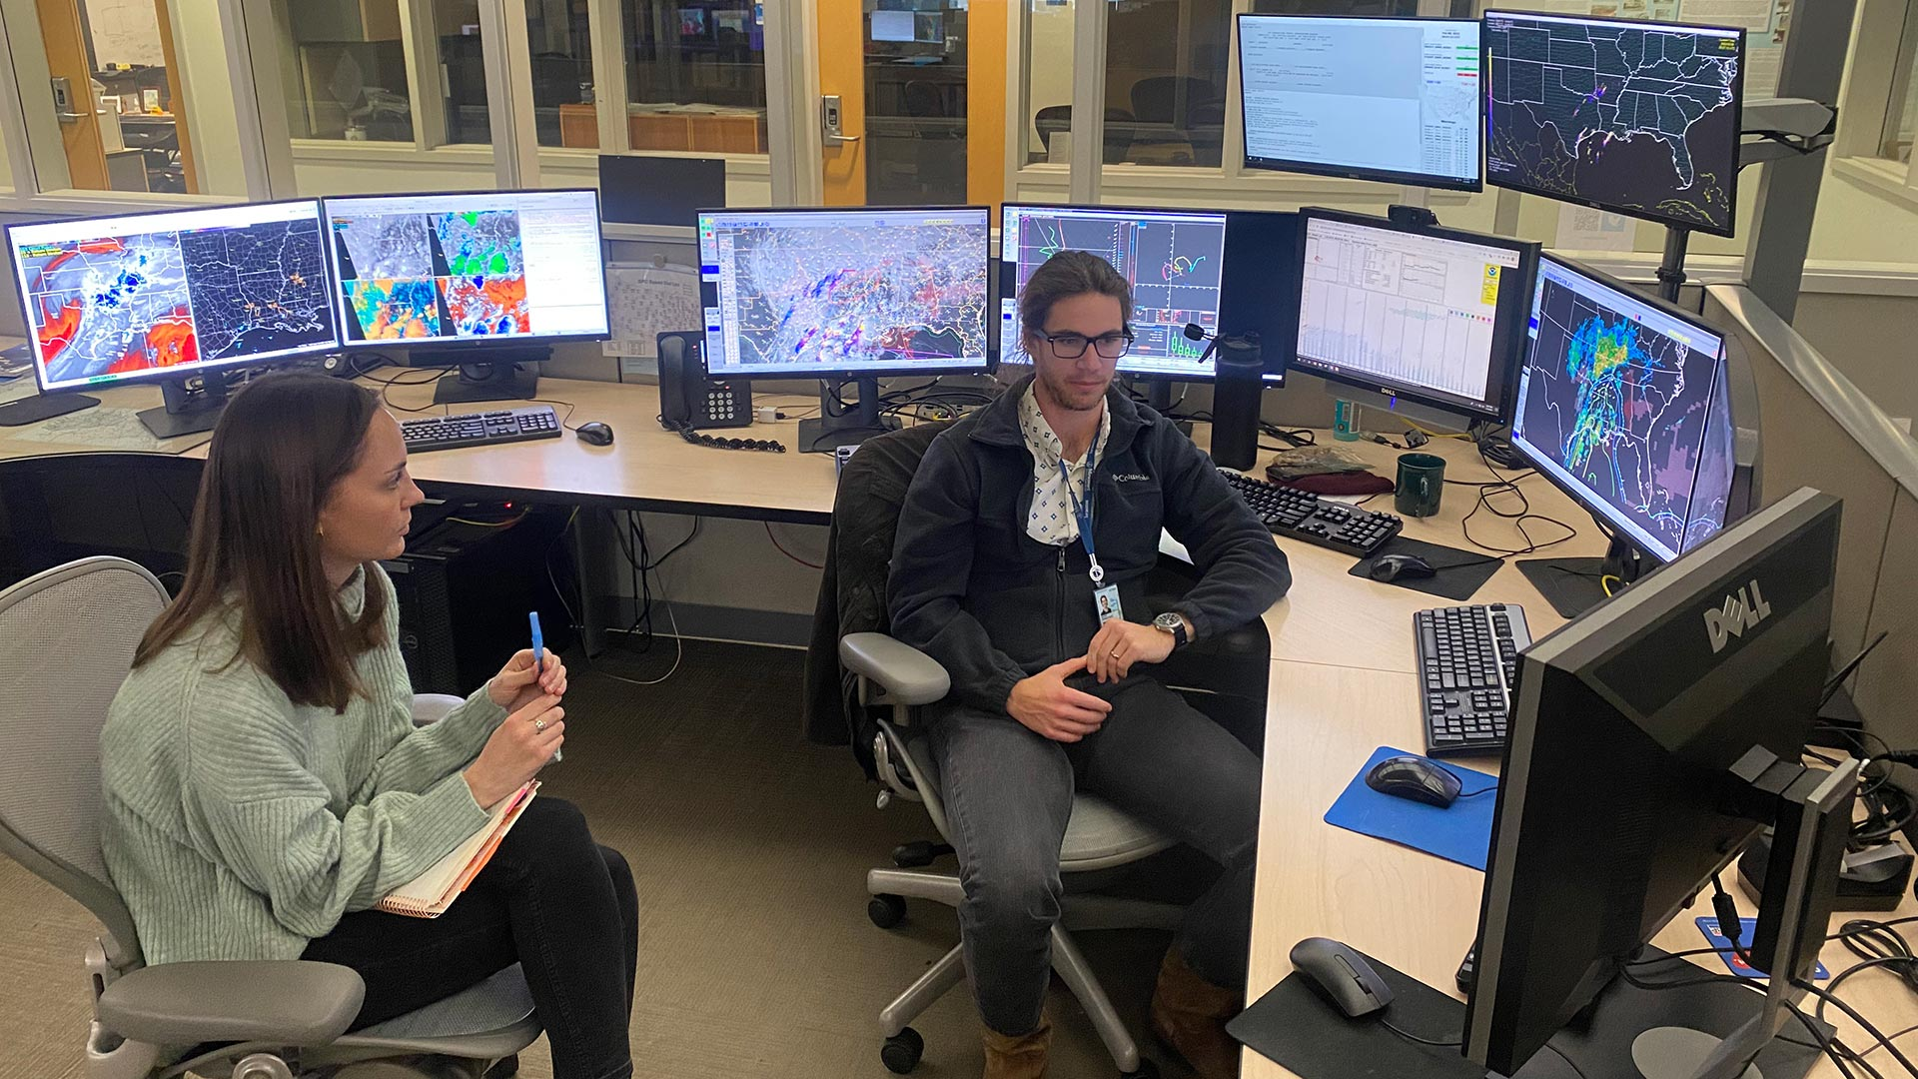
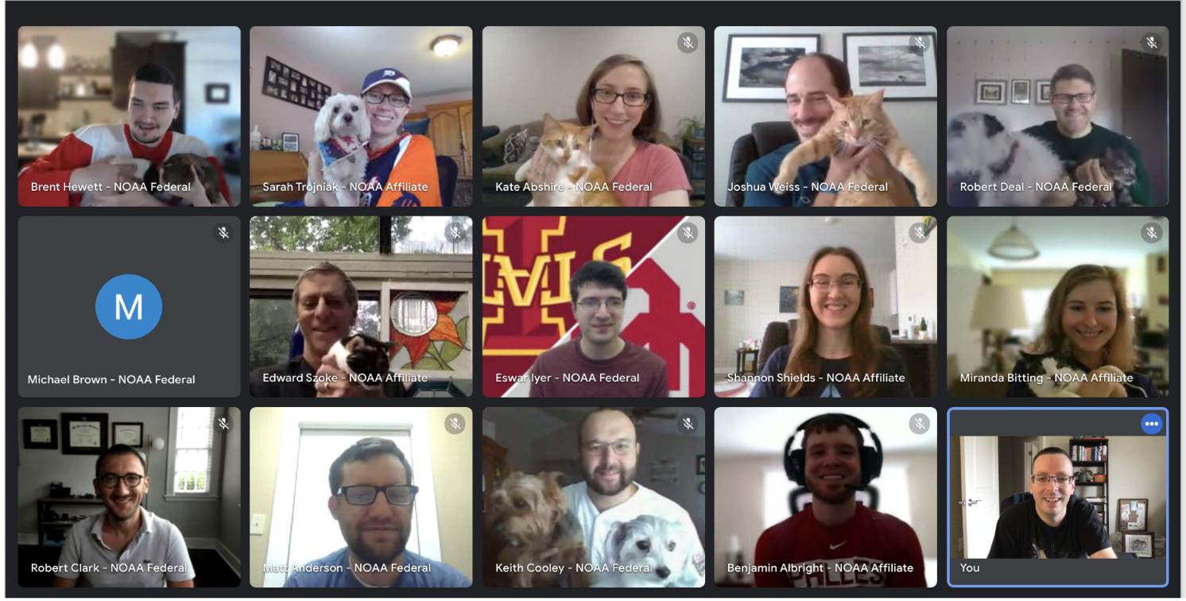
Collaboration with forecasters has been key to the improvement of these ML-based systems!

Slide 16

Summary
Machine learning techniques can help in post-processing NWP output to yield useful “first guess” guidance for operations
ML models for severe weather are skillful, and competitive with operational outlooks – especially beyond day 1
Plenty of opportunities for further advances, both in the forecasts themselves, and how they can be applied: what’s the best way to make them useful and trustworthy for forecasters?
Thank you!
aaron.hill@colostate.edu
russ.schumacher@colostate.edu
Real-time forecast graphics: http://schumacher.atmos.colostate.edu/hilla/csu_mlp/

Slide 17
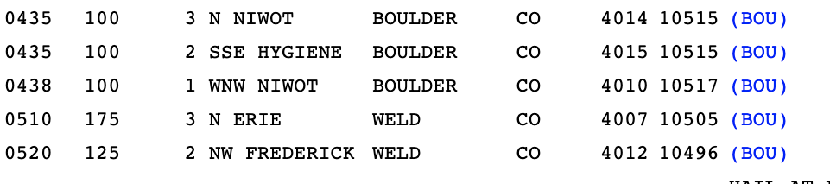
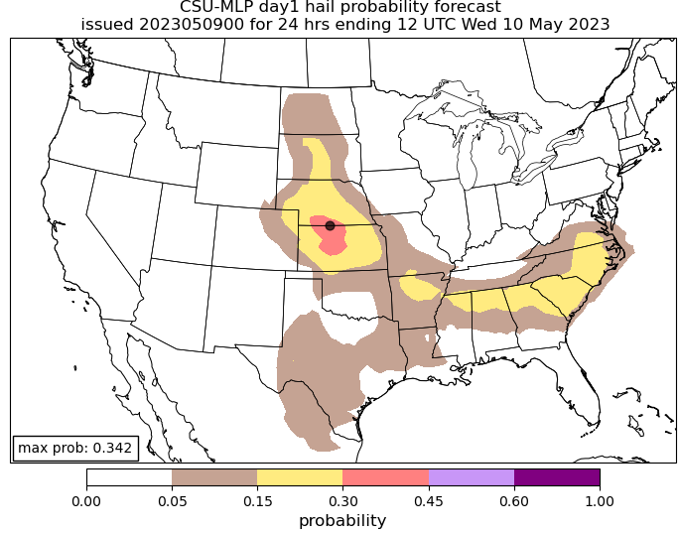
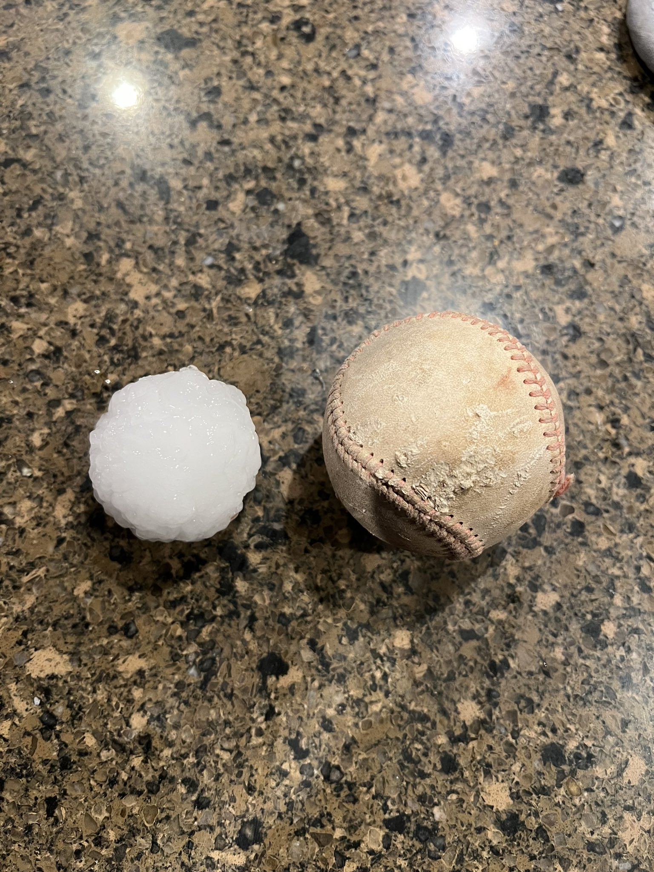
Front Range Storms 5/9
Day 1 Hail: Valid until 1200 UTC this morning
Twitter: @GMoore34
11pm-12am local time

Slide 18
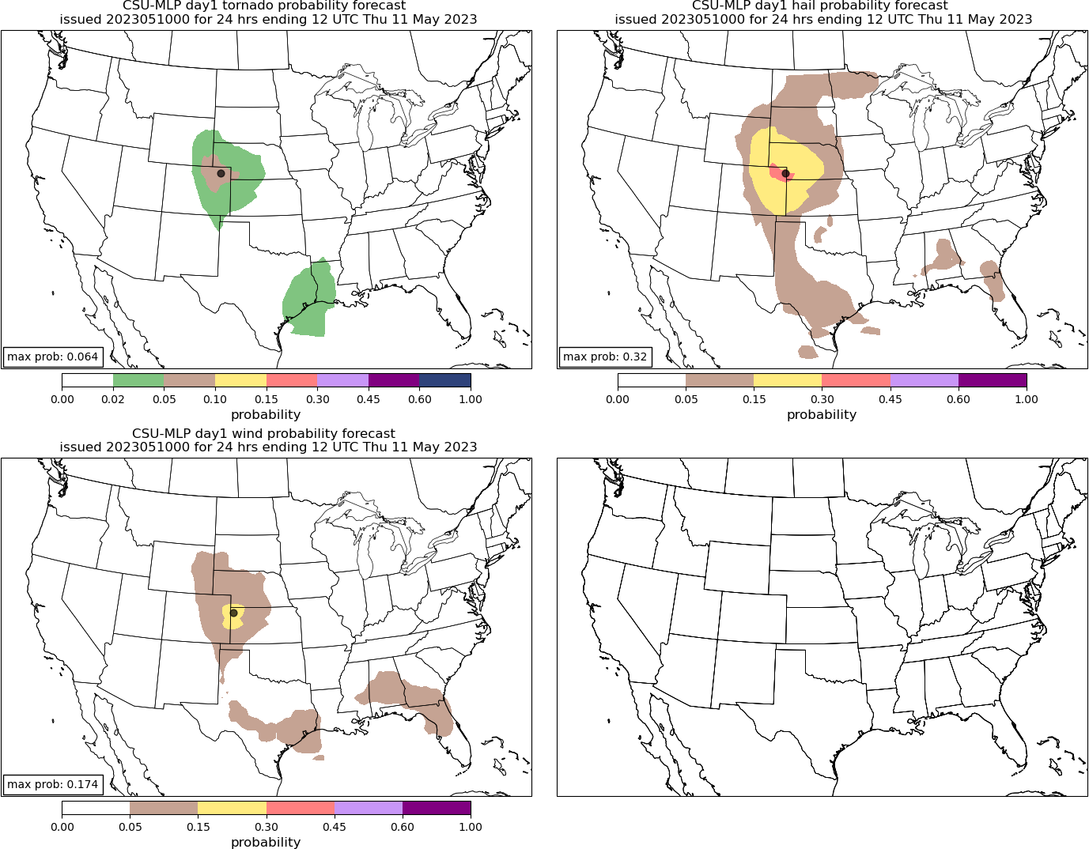
Front Range Storms 5/10?
Day 1 Tor, Hail, and Wind: Valid until 1200 UTC 11 May
TOR
HAIL
WIND

Slide 19
Summary
Machine learning techniques can help in post-processing NWP output to yield useful “first guess” guidance for operations
ML models for severe weather are skillful, and competitive with operational outlooks – especially beyond day 1
Plenty of opportunities for further advances, both in the forecasts themselves, and how they can be applied: what’s the best way to make them useful and trustworthy for forecasters?
Thank you!
aaron.hill@colostate.edu
russ.schumacher@colostate.edu
Real-time forecast graphics: http://schumacher.atmos.colostate.edu/hilla/csu_mlp/

Slide 20
Backup Slides

Slide 21
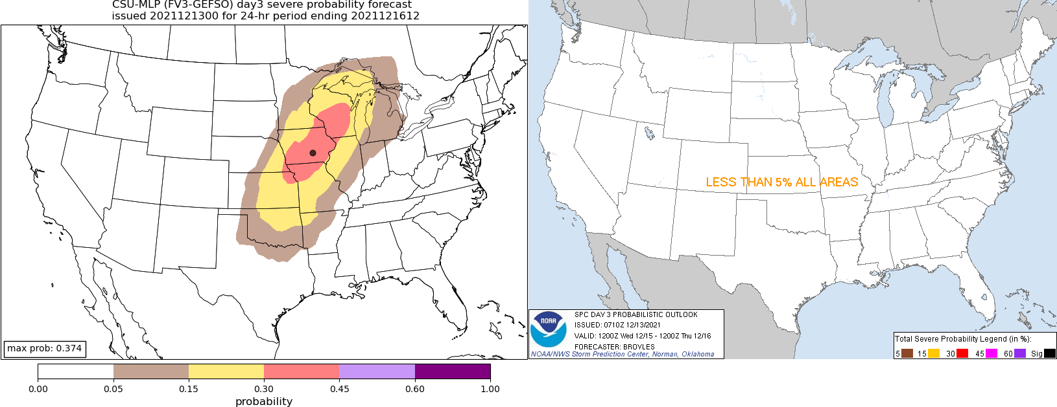
First example case: 15-16 December 2021 outbreak
SPC Day 3 outlook, issued 0710 UTC 13 December
CSU-MLP day 3 forecast from 0000 UTC GEFS

Slide 22
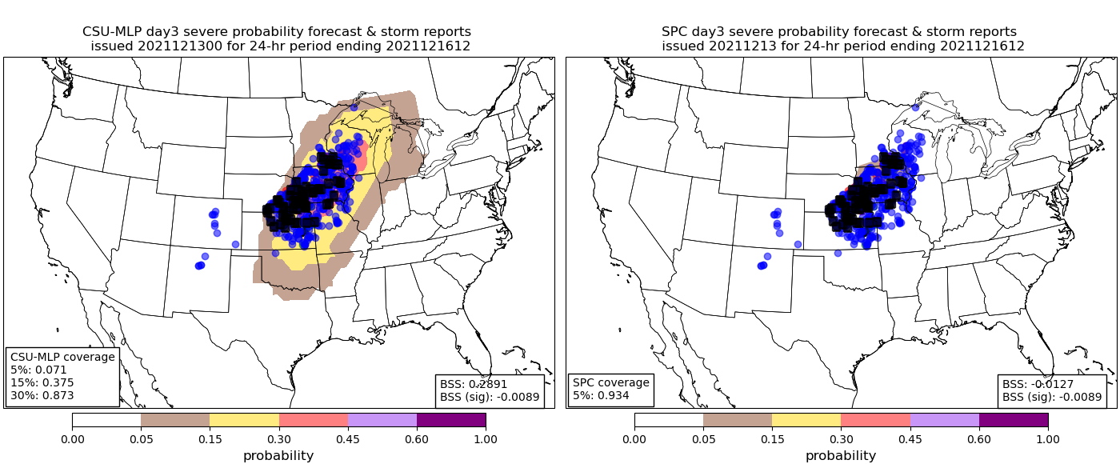

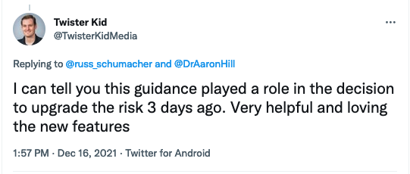
15-16 December 2021 outbreak: home run for CSU-MLP
SPC Day 3 outlook, issued 1815 UTC 13 December
CSU-MLP day 3 forecast from 0000 UTC GEFS
SPC BSS = 0.0
CSU BSS = 0.34

Slide 23
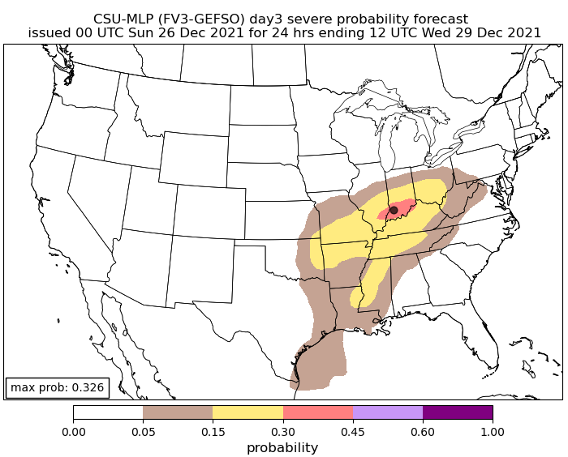
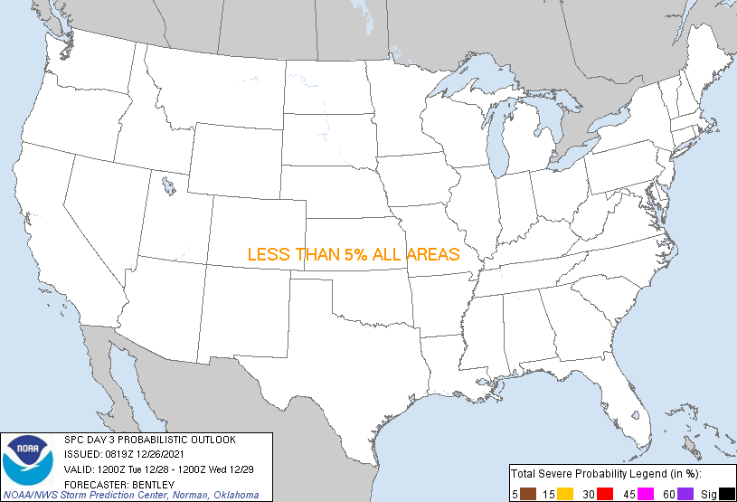
Second example case: 28-29 December 2021
SPC Day 3 outlook, issued 0819 UTC 26 December
CSU-MLP day 3 forecast from 0000 UTC GEFS

Slide 24
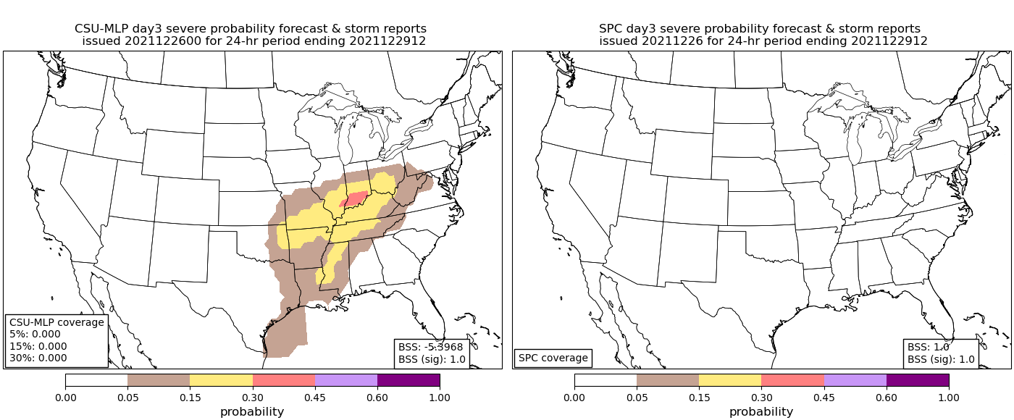

28-29 December 2021: swing and a miss
SPC Day 3 outlook, issued 0710 UTC 13 December
CSU-MLP day 3 forecast from 0000 UTC GEFS
@PitchingNinja
SPC BSS = 0.0
CSU BSS = -7.42

Slide 25
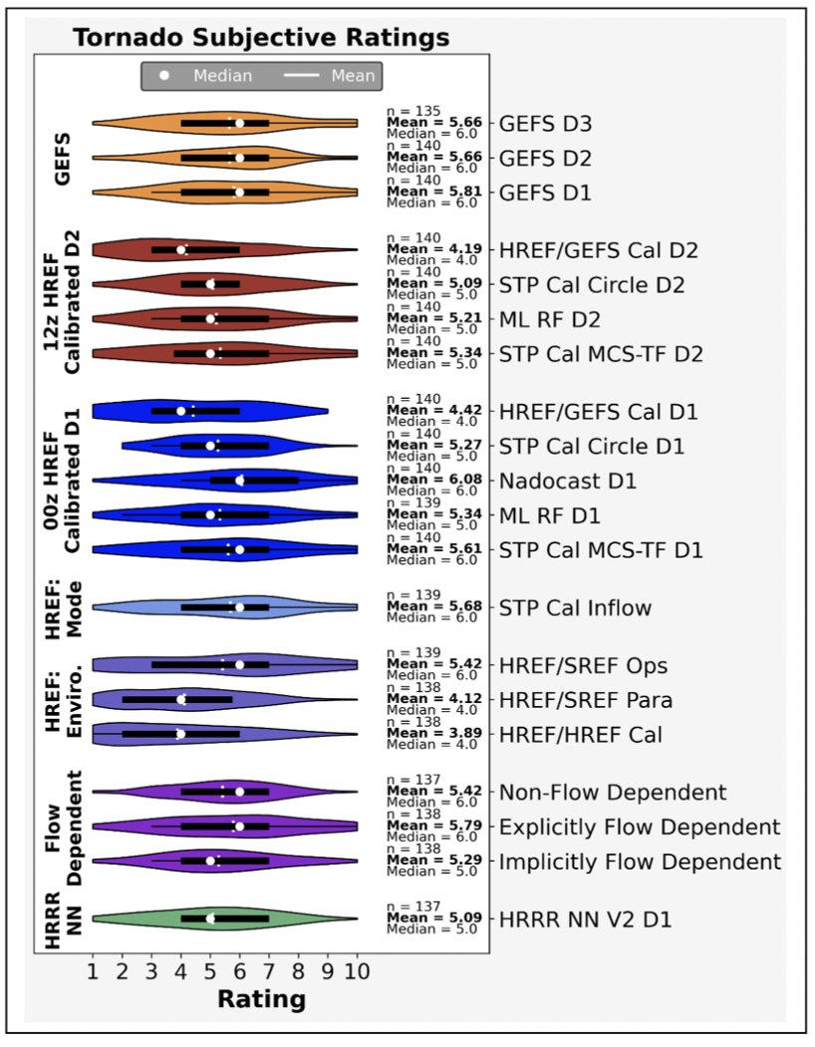
How do Hazardous Weather Testbed participants view this guidance?
“Despite using a coarse global ensemble as input, the GEFS tornado guidance received relatively high ratings from Day 3 to Day 1. In aggregate, the GEFS Day-3 product scored identically to the GEFS Day-2 product.”
“The day 1 and 2 GEFS [hail] forecasts performed particularly well relative to the other guidance products, especially considering the coarse global ensemble input. With that said, some participants felt that the GEFS products covered too large of areas, particularly at shorter lead times.”
https://hwt.nssl.noaa.gov/sfe/2022/docs/HWT_SFE_2022_Prelim_Findings_FINAL.pdf

Slide 26
How do Hazardous Weather Testbed participants view this guidance?
“Despite using a coarse global ensemble as input…”
“…especially considering the coarse global ensemble input…”
There is a great deal of information in large-scale environments!
https://hwt.nssl.noaa.gov/sfe/2022/docs/HWT_SFE_2022_Prelim_Findings_FINAL.pdf

Slide 27
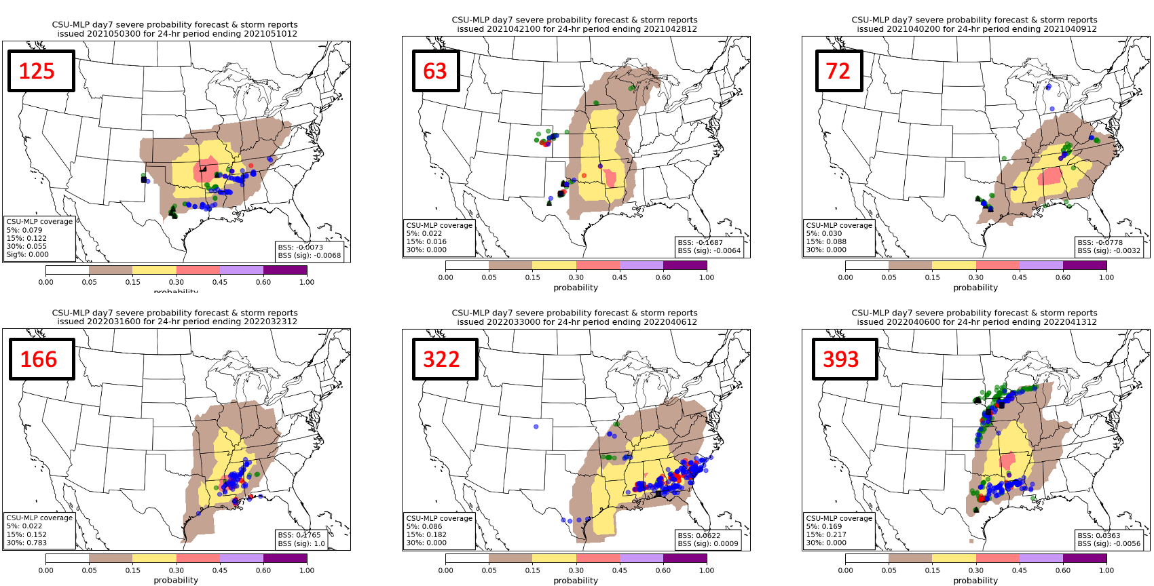
Are high impact days connected to higher probabilities at longer lead times?

Slide 28
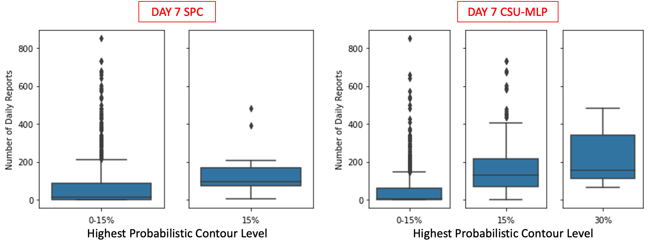
Can SPC exploit this information? Forecasters already do in some respects…

Slide 29
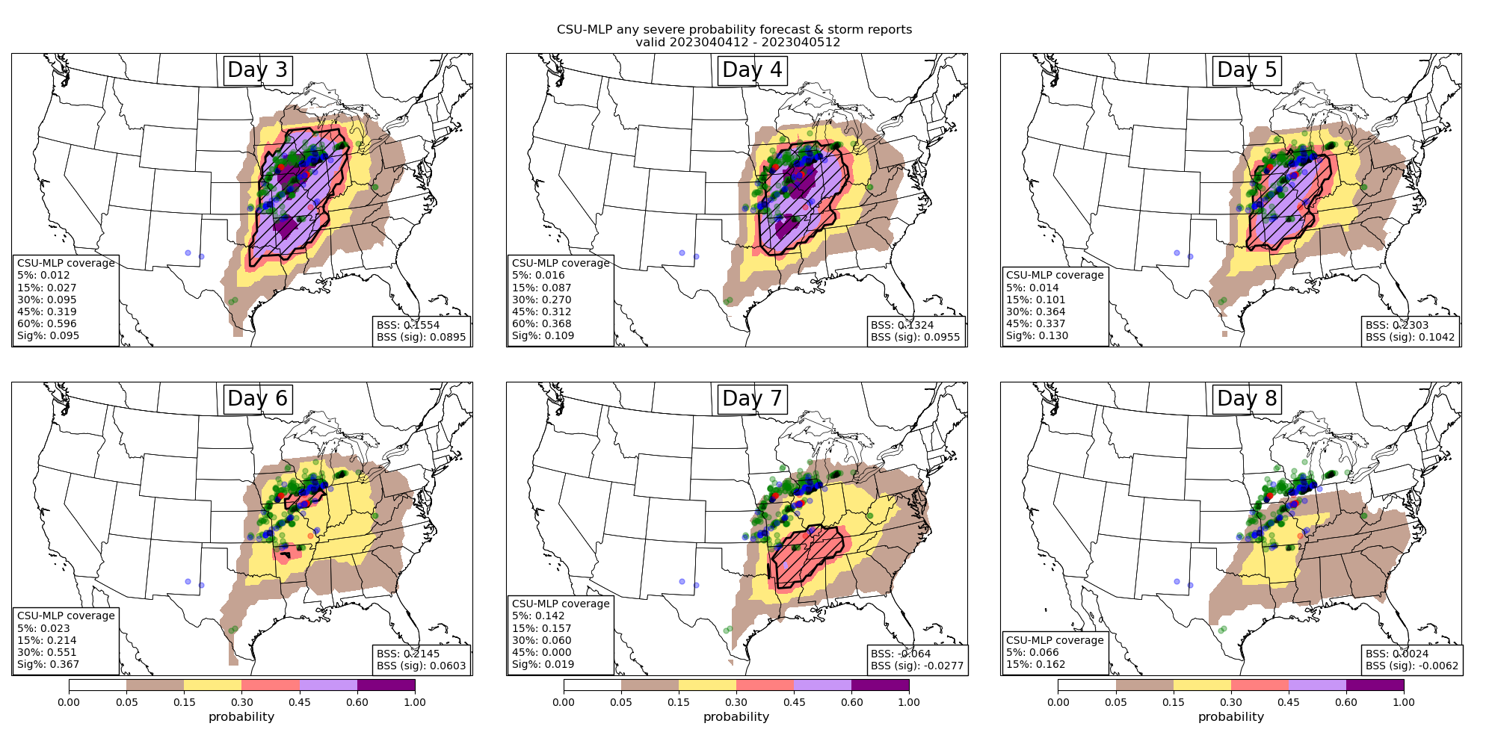
4 April 2023 supposed-to-be outbreak

Slide 30
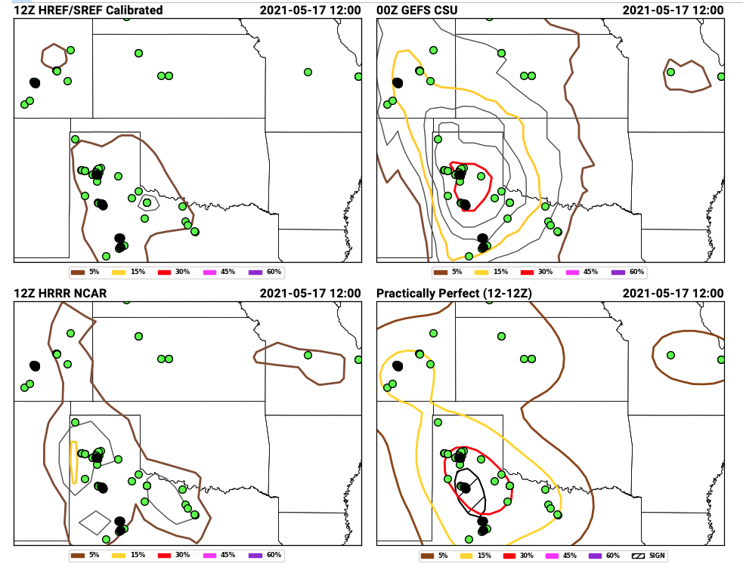
These forecasts were demonstrated and evaluated during the Hazardous Weather Testbed Spring Forecasting Experiment
Day-2 hail forecasts issued 15 May 2021, valid 16-17 May 2021
Day-2 hail forecasts issued 15 May 2021, valid 16-17 May 2021
https://hwt.nssl.noaa.gov/sfe_viewer/2021/outlook_verification/

Slide 31
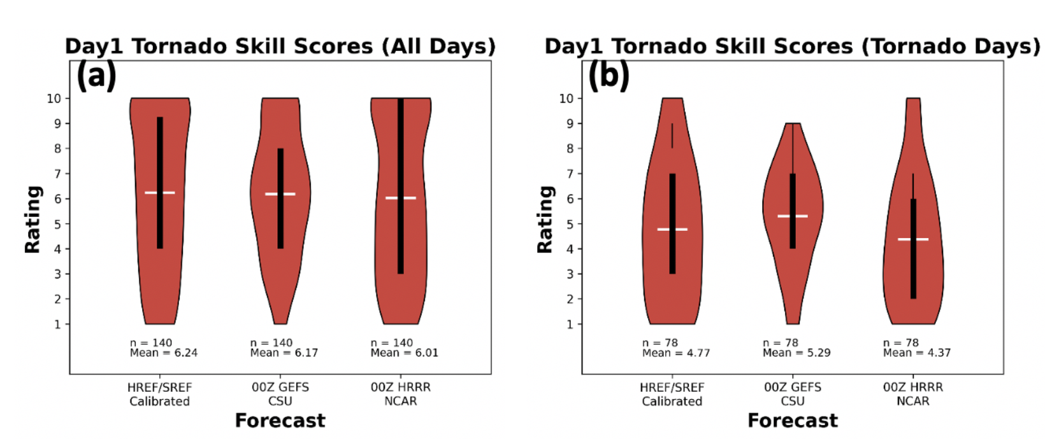
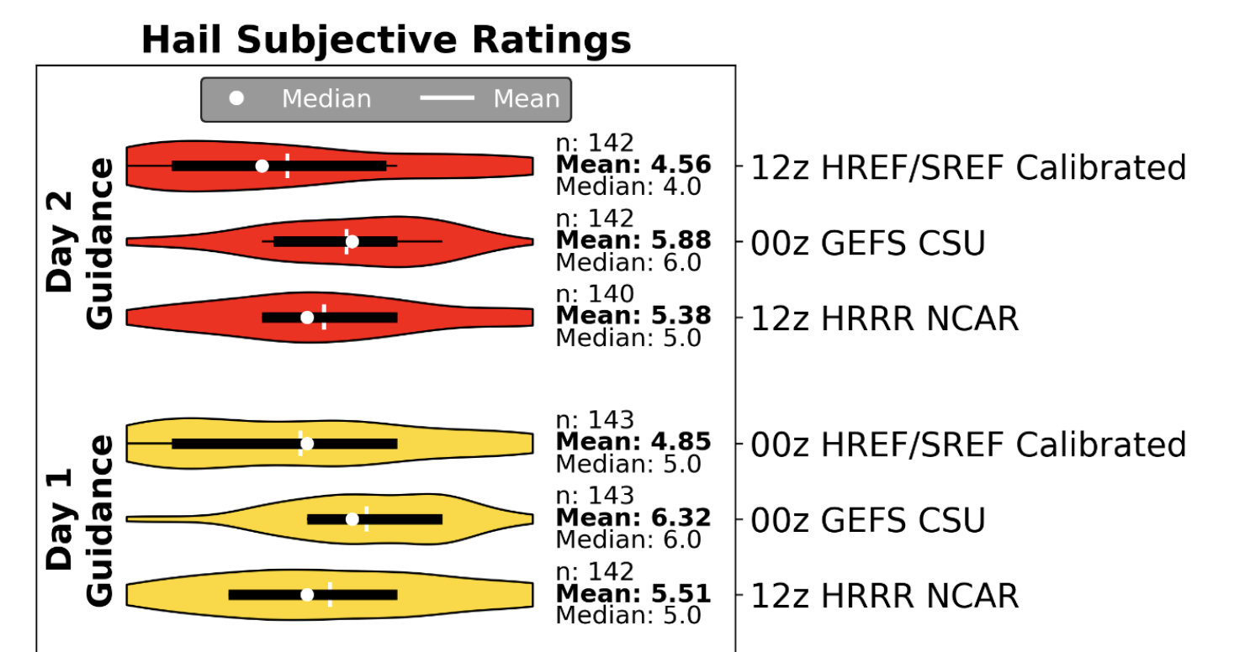
Subjective evaluations by participants (1-10 scale)
“For the set of tornadic days [for day 1 guidance], GEFS CSU performs the best with a mean skill score of 5.39 as compared to the other two methods, which have mean score values less than 4.8.”
[For day 1 hail guidance], “GEFS CSU received the greatest mean participant rating (6.32), followed by HRRR NCAR (5.51) and HREF/SREF (4.85; yellow violins in Fig. 6).”
https://hwt.nssl.noaa.gov/sfe/2021/docs/HWT_SFE_2021_Prelim_Findings_FINAL.pdf

Slide 32
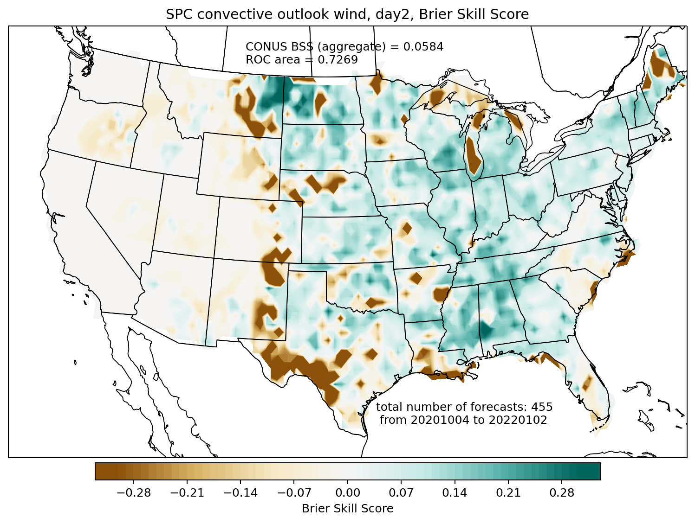
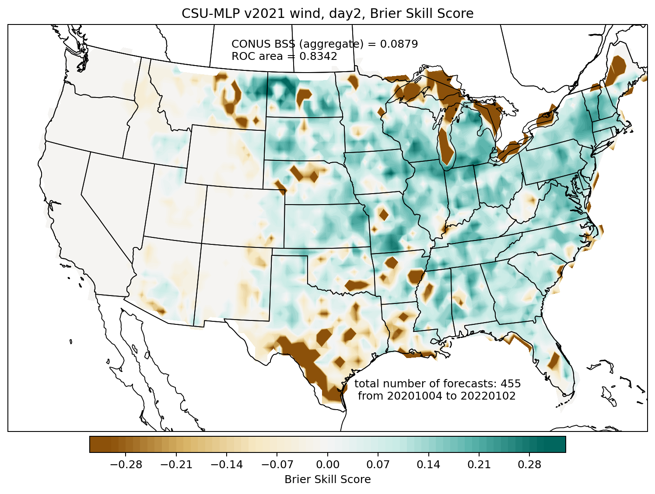
Brier skill score comparison: day 2 wind
SPC convective outlook
CSU-MLP
CSU-MLP showed higher skill, especially in the Great Lakes and northeast

Slide 33
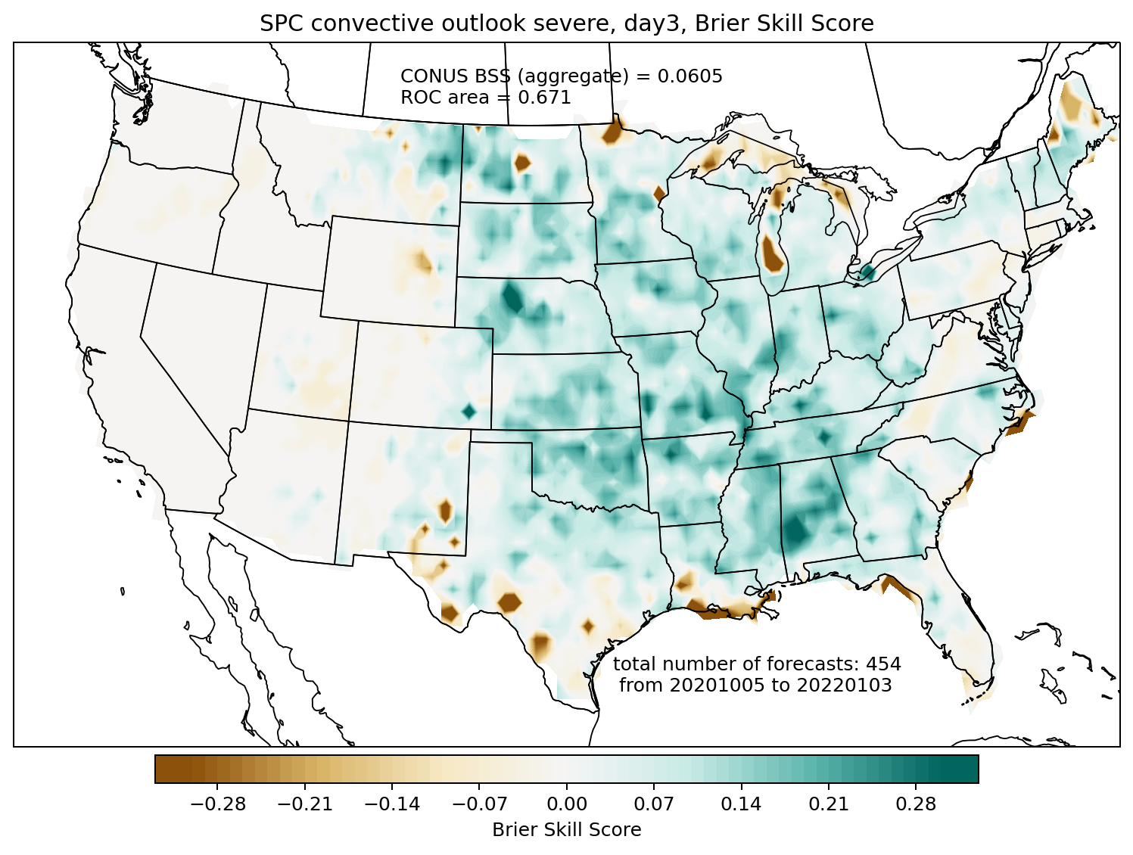
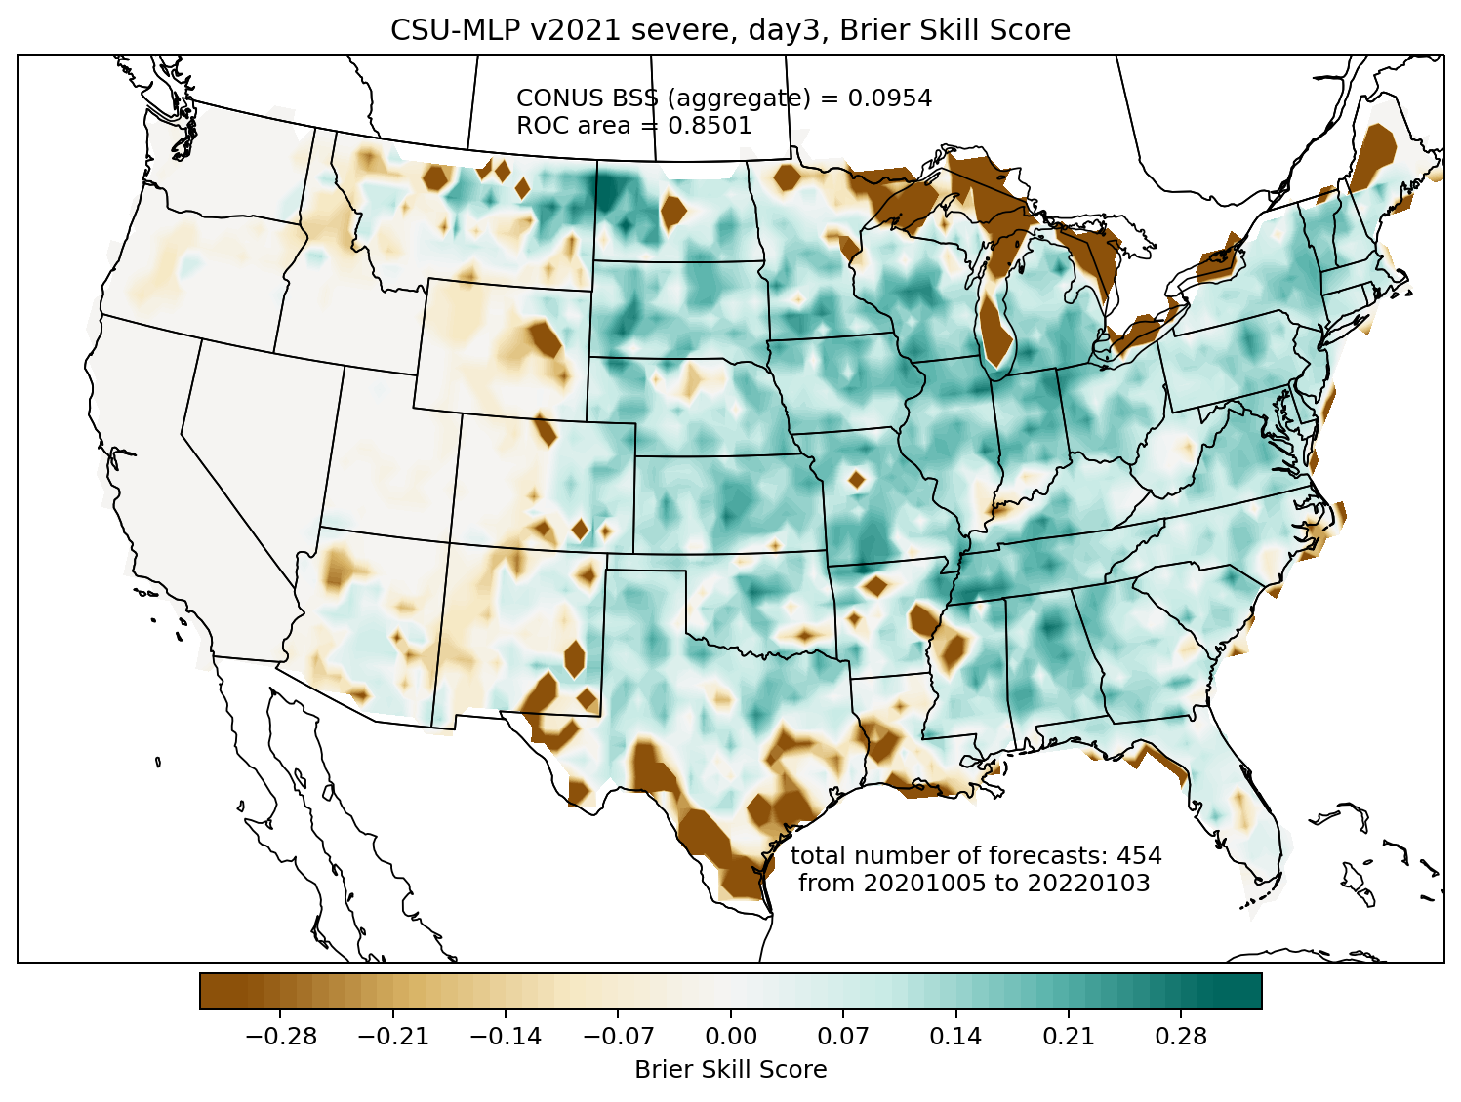
Brier skill score comparison: day 3 severe
SPC convective outlook
CSU-MLP
CSU-MLP significantly more skillful on day 3: it takes a lot more swings, and hits some big home runs, at the expense of also some big misses

Slide 34
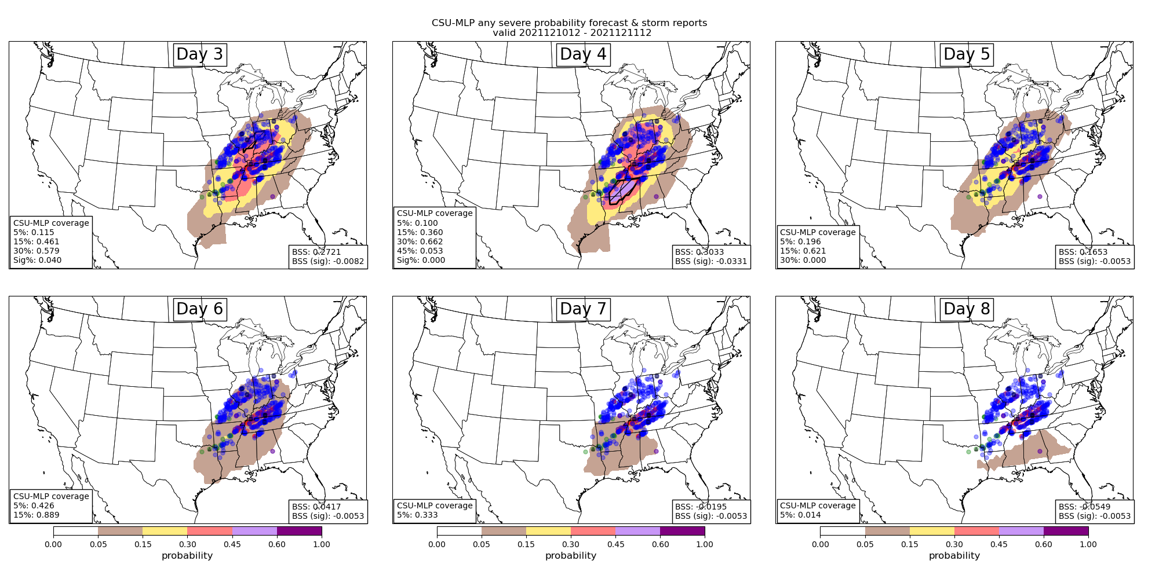
Example Forecasts
Valid 1200 – 1200 UTC 12/10/21 – 12/11/21
Hill et al. 2022, in prep

Slide 35
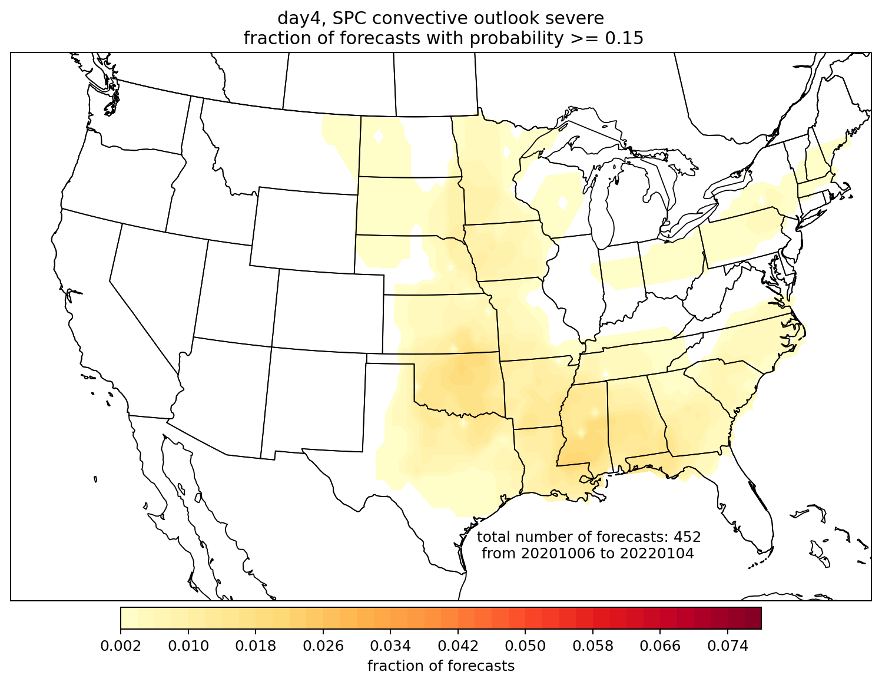



Frequency of occurrence day 4 forecasts
SPC > 15%
CSU > 15%
2 October 2020 – 31 December 2021
FV3-GEFS became operational October 2020
SPC > 30%
CSU > 30%
Hill et al. 2022, in prep

Slide 36



Still Learning…
Day 4
BSS: 0.303
Day 4
BSS: -0.054
BSS: 0.046
BSS: -0.028
Day 4
CSU RFs seem to benefit from frequently “swinging” at low-probability events (issuing low-probability forecasts)
But busts still occur…the “why” is a critical research question → interpretability metrics
BSS: 0.238
BSS: 0.221

Slide 37

Still Learning…

Slide 38
Summary and Next Steps
Day 1 forecasts compare similarly to SPC outlooks; skill gap (i.e., ML better) increases at day 2 and significantly at day 3
Reasonable RF-forecast skill and resolution out to day 6, likely a result of more frequent issuances of low-probability contours
CSU-MLP issues far more frequent probability contours; SPC is conservative when issuing outlooks, but tends to correctly forecast events when outlooks are issued
What do the models rely on to make their forecasts? Interpretability
How can we leverage day-prior forecast information to inform the RFs?
Constant feedback and discussion with SPC (and NWS offices!!) to tailor products to their needs, e.g., day 9 and 10 forecasts, day 3 individual hazards
Contact: Aaron Hill (aaron.hill@colostate.edu)
Russ Schumacher (russ.schumacher@colostate.edu)

Slide 39

Summary and Next Steps
Day 1 forecasts compare similarly to SPC outlooks; skill gap (i.e., ML better) increases at day 2 and significantly at day 3
Reasonable RF-forecast skill and resolution out to day 6, likely a result of more frequent issuances of low-probability contours
CSU-MLP issues far more frequent probability contours; SPC is conservative when issuing outlooks, but tends to correctly forecast events when outlooks are issued
What do the models rely on to make their forecasts? Interpretability
How can we leverage day-prior forecast information to inform the RFs?
Constant feedback and discussion with SPC (and NWS offices!!) to tailor products to their needs, e.g., day 9 and 10 forecasts, day 3 individual hazards
Andrew Lyons, SPC Forecaster
Contact: Aaron Hill (aaron.hill@colostate.edu)
Russ Schumacher (russ.schumacher@colostate.edu)

Slide 40
Summary and Next Steps
Day 1 forecasts compare similarly to SPC outlooks; skill gap (i.e., ML better) increases at day 2 and significantly at day 3
Reasonable RF-forecast skill and resolution out to day 6, likely a result of more frequent issuances of low-probability contours
CSU-MLP issues far more frequent probability contours; SPC is conservative when issuing outlooks, but tends to correctly forecast events when outlooks are issued
What do the models rely on to make their forecasts? Interpretability
How can we leverage day-prior forecast information to inform the RFs?
Constant feedback and discussion with SPC (and NWS offices!!) to tailor products to their needs, e.g., day 9 and 10 forecasts, day 3 individual hazards
Contact: Aaron Hill (aaron.hill@colostate.edu)
Russ Schumacher (russ.schumacher@colostate.edu)

